Slide 1

QuickBite Express
Business Recovery Report

Slide 2
SIX OBJECTIVES
ORDER PATTERNS
CUSTOMER SEGMENTS
DELIVERY PERFORMANCE
Analyze order trends to uncover behavioral changes across the three phases (pre-crisis, crisis, recovery).
Assess delivery times, cancellations, and SLA compliance to pinpoint operational gaps (e.g., the 55% SLA failure).
Identify which customers can be recovered and which need entirely new acquisition strategies.
CAMPAIGN OPPORTUNITIES
RESTAURANT PARTNERSHIPS
FEEDBACK & SENTIMENTS
Recommend targeted initiatives (e.g., cashbacks, guarantees) to rebuild trust and loyalty across demographics.
Predict which partnerships are most valuable for long-term retention and which are most likely to churn (e.g., Cloud Kitchens vs. Restaurants).
Monitor real-time ratings, reviews, and sentiment to guide ongoing recovery efforts and prove the cause-and-effect link between operational failure and trust collapse.

Slide 3










DATA PIPELINE
01
02
03
04
05
Raw Data(Input Stage)
Staging & Validation
Cleaning & Transformation
Data Modeling
Power BI Dashboard
Import all raw files into staging area before modeling.
✅ 8 raw CSVs provided — combined transactional + dimensional data
Checks Done:
1.Primary key uniqueness
2.Foreign key consistency
3.Amount reconciliation logic
4.Non-null and value range checks
5.Referential integrity
Tasks Done:
1.Removed invalid and null
2.Fixed inconsistent
3.Derived columns
4.Converted date/time fields into correct formats (Y-M-D)
1.Central fact table: Linked with Four Dimension tables
2.Snowflake schema with proper relationships
3.Added calculated measures: total revenue, average rating, SLA compliance, etc..
1.Connected MySQL → Power BI (Import Mode)
2.Built measures and KPIs
3.Designed interactive visuals (line, pie, map, word cloud, etc.)

Slide 4
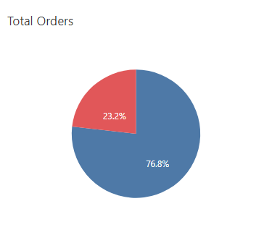
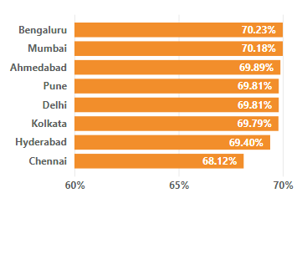
70%
Order Drop In Crisis Phase compare to Pre-Crisis.
+70%
Benguluru and Mumbai saw most decline.

Slide 5
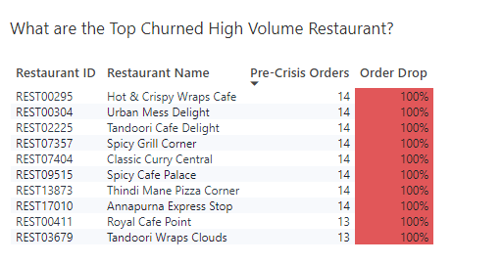
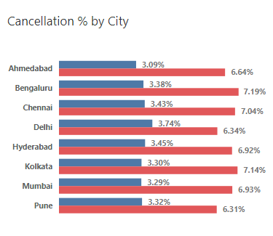
212
High-Volume Restaurant saw absolute decline in order count(-100%)
+7%
Benguluru and Kolkata saw highest cancellation in Crisis Phase.

Slide 6
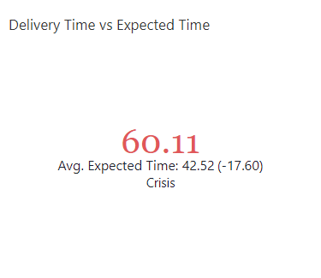
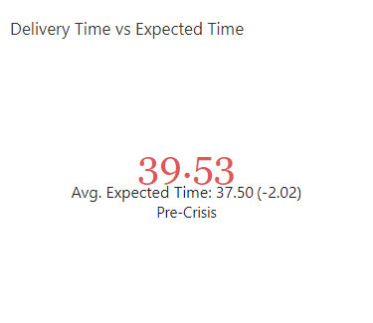
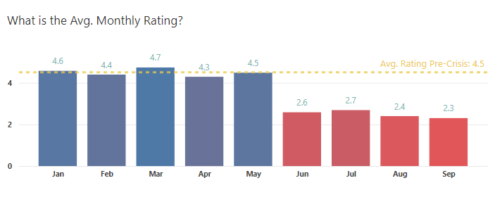
-17 Mins
Average Delay in Crisis Period compared to 2 Mins delay in Pre-Crisis Period.
+2
Sudden drop can be seen in rating in start of crisis phase, June.

Slide 7
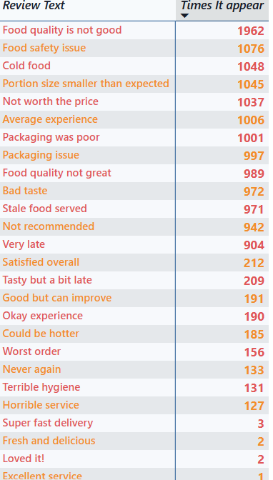
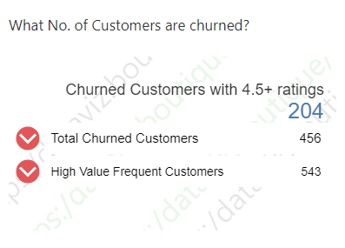
1962
Times the ‘Food quality is not good’ appear along with all other negative comments.
204
Customers who ordered 4 or more times and gave rating 4.5 almost Everytime in Pre-Crisis are completely left in Crisis.

Slide 8
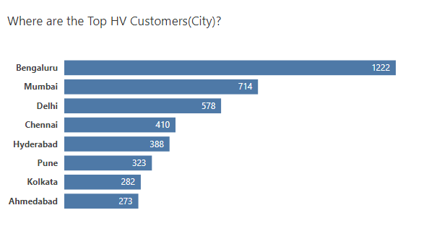
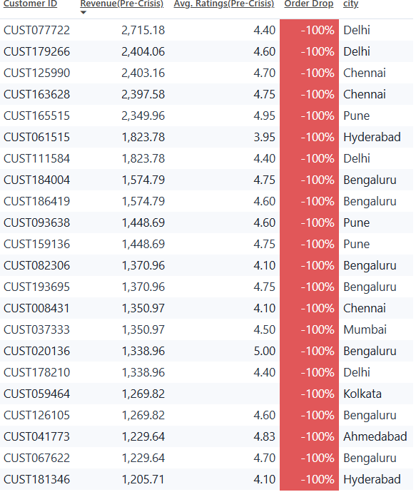
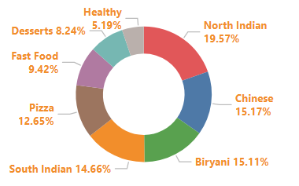
3520
Top 5% customers by Revenue who completely left the platform.
55.5%
+50%
Orders are late for those customers.
Benguluru, Mumbai and Delhi account for more than half of those.
+30%
North Indian & Chinese are most popular among those customers.

Slide 9
KEY RECOMMENDATION & OPPORTUNITY
Operational Excellence & Trust
Customer Re-acquisition & Targeting
The 55.63% pre-crisis SLA miss rate for high-value customers was the root cause of the trust collapse.
Bengaluru, Mumbai, and Delhi where 50% of the highest-volume orders were lost. Offer immediate, temporary financial incentives to DPs to reduce the SLA miss rate below within 30 days.
Immediately deploy a 50% high-value discount campaign focused only on the 3,520 high-value customers who showed 100% churn. Address the core negative keywords (from the Word Cloud). Offer customers a 100% "QuickBite Safety Guarantee" on their first recovery order.
Partnership Stability
Strategic Alignment & Future Planning
Offer volatile partners guaranteed minimum order volumes for the next six months to stabilize supply and prevent competitor leakage. Isolate the partners in the Top Right Quadrant (High Revenue, High Delay). These partners require immediate, one-on-one operational intervention/training before they cause further customer churn
Freeze any increase in the Paid Acquisition Budget. The 53.43% drop in conversions shows money is being wasted on a trust-deficient brand. Reallocate funds to trust-building content (e.g., videos of safety audits) before increasing ad spend.

Slide 10

THANKS!
Do you have any questions?
akashguptard8083@gmail.com
+91 9508052015 | https://itsaakashgupta.github.io/

